Slide 1
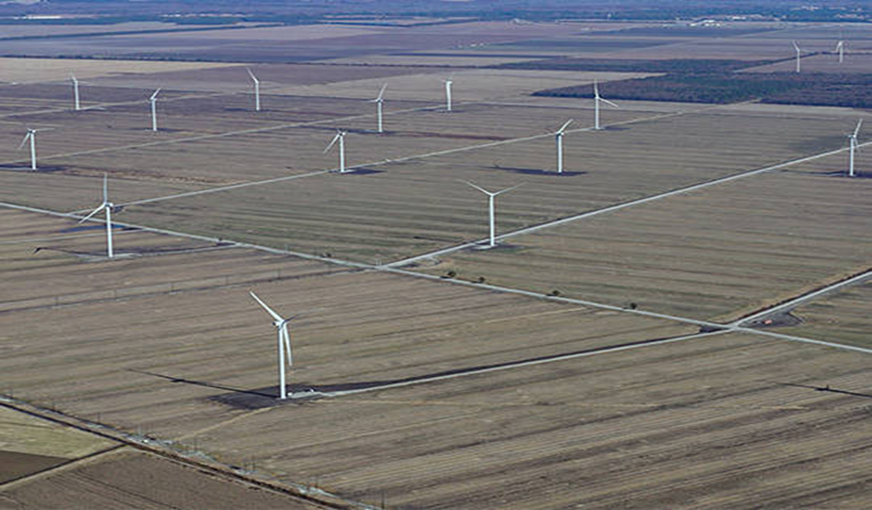
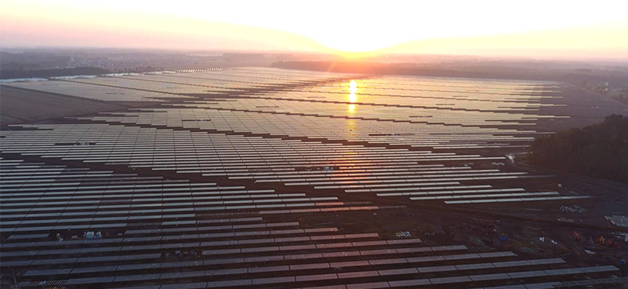
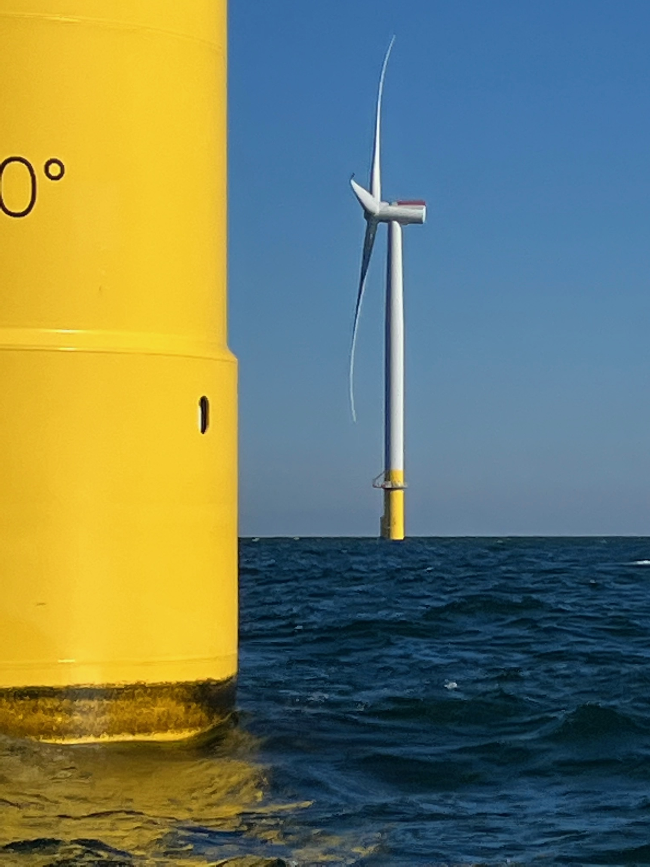
Renewable Energy
Lessons Learned From North Carolina
Representative John Szoka
NC House of Representatives

Slide 2
Easter morning 1900: 5th Ave, NYC. Spot the automobile.

Slide 3
Easter morning 1913: 5th Ave, NYC. Can you spot a horse? Why NOT?

Slide 4
Policy – Innovation & Technology - Cost
Public Policy to Achieve a Desired Result
Which may be Achieved by Innovation & Technology
Cost Considerations

Slide 5
What Are Your Energy Policy Goals?
Potential Goals
Reduce cost of electricity to Ratepayers
Reduce the rate of increase of cost of electricity production
Encourage competition between all sources of energy production (to reduce costs)
Support existing energy producers
Increase responsiveness, and reliability, of grid to natural disasters
Encourage growth of renewable energy – lower cost, create jobs
Increase opportunities for current businesses to expand to support renewable energy producers
Increase revenues to the state

Slide 6
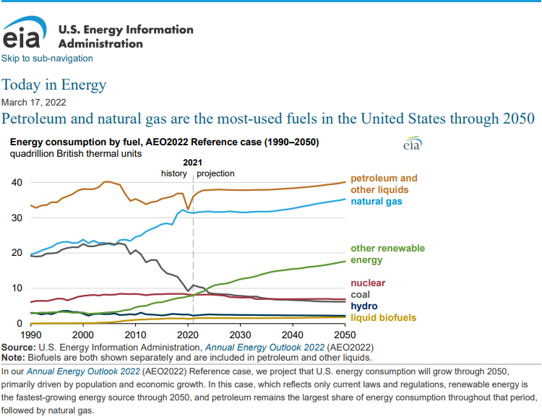

Slide 7
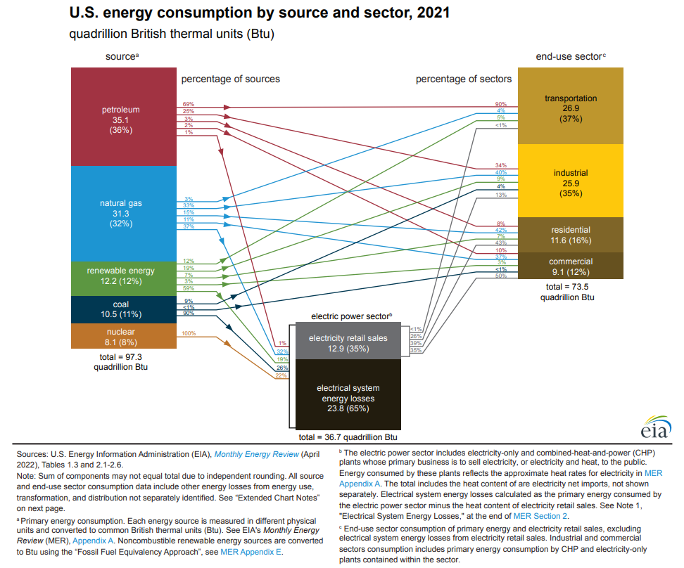

Slide 9
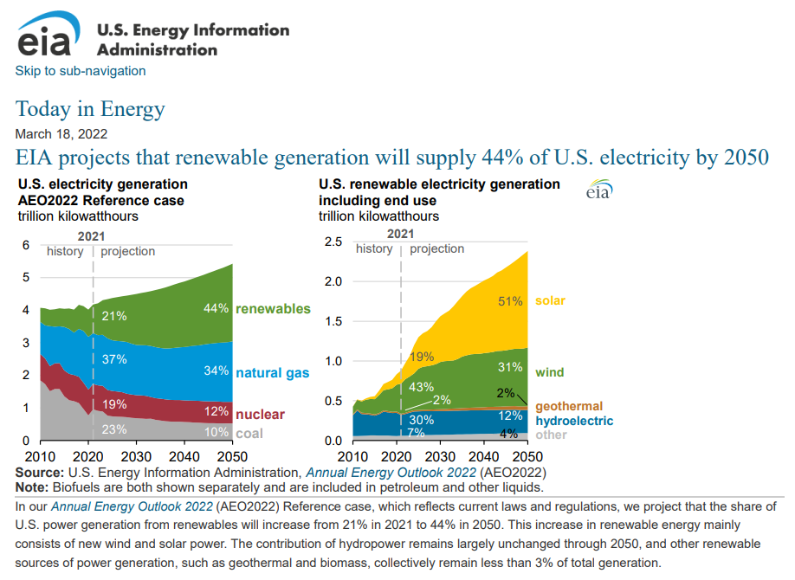

Slide 10
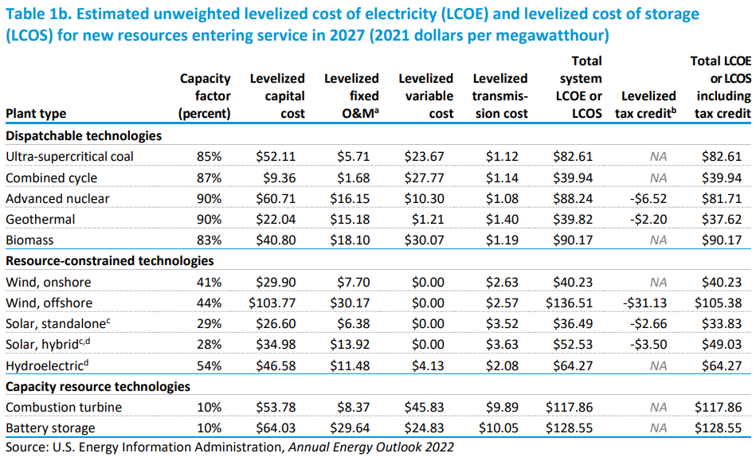

Slide 11
Legacy Federal Energy Policy- PURPA
Public Utility Regulatory Policies Act of 1978 (PURPA) passed with the intention of:
Conserving electric energy
Increasing efficiency in facilities and resources used by utility companies
Making retail rates for electric consumers more fair
Speeding up the creation of hydroelectric energy production at small dams
Conserving natural gas
PURPA encouraged:
Creating a market for power from non-utility power producers
Increased efficiency by making use of cogeneration
Ending promotional rate structures
Encouraging the development of hydroelectric power
The conservation of electric energy and natural gas
PURPA implementation left to the states

Slide 12
Legacy Federal Energy Policy- PURPA
PURPA implementation left to the states
Forced electric utilities to buy power from more efficient producers, such as cogeneration plants – produce electricity and steam – if cost less than avoided cost
Led to a new class of generating facilities, qualifying facilities (QFs) which received special rate and regulatory treatment
Cogeneration facilities
Small Power Production Facilities
80MW or less (Federal law)
Uses renewable sources – Hydro, wind or solar – as its primary energy source
NC implementation was set at 5MW to be a QF

Slide 13
Solar Policy Changes in North Carolina
80% Property tax abatement for Solar Facilities
2017 HB589 – Competitive Energy Solutions for North Carolina
2019 S559 – Storm Securitization/Alt. Rates
2021 HB 951 – Energy Solutions for North Carolina

Slide 14
2017 House Bill 589, Competitive Energy Solutions for North Carolina
NC House version was a compromise reached over 30 stakeholder meetings.
Specifically, House Bill 589:
Reforms PURPA implementation by improving solar interconnection process
Grandfathers at least 3,500 MW legacy PURPA PV, operational and in the queue
Establishes Competitive Procurement, at or below avoided cost, of 2,660 MW
As of 2021 over $350 million in documented ratepayer savings
Restarts Green Source Rider program for Industry, Academic Institutions, and to assist military in energy security on bases (600MW set aside).
Formally legalizes leasing of rooftop systems(capped at 1% of NC peak,~250 MW)
Creates rooftop solar rebate (100 MW, 5 years) (voluntary Duke Energy program)
Creates Community Solar program (40 MW)
Allows at least 200 MW of 10 year “standard contract” 1 MW or less, PURPA QFs
In total, should result in a minimum of 6,800 – 7,350 MW of PV in Duke Energy territories by 2022

Slide 15
2019 Senate Bill 559, Securitization/Alt Ratemaking
Storm Securitization (Passed in Final Bill)
Create the storm recovery charge and provides that the revenues generated by this charge, known as storm recovery property, is a property right that can be transferred and pledged as security for storm recovery bonds.
Authorizing Rates Using Alternative Mechanisms (Failed)
“Banded ratemaking” that essentially ensures the utility received its rate of return.

Slide 16
2021 House Bill 951, Energy Solutions for NC
Carbon Reduction/Fuel Transition/Decommissioning
70% Carbon reduction by 2030
Carbon Neutral by 2050
NC Utilities Commission given broad authority
Performance-Based Regulation of Electric Public Utilities ******
Performance-Based Regulation Authorized
Multi-Year Rate Plan
Rulemaking
“Blend and Extend” PPA with Eligible Small Power Producers

Slide 17
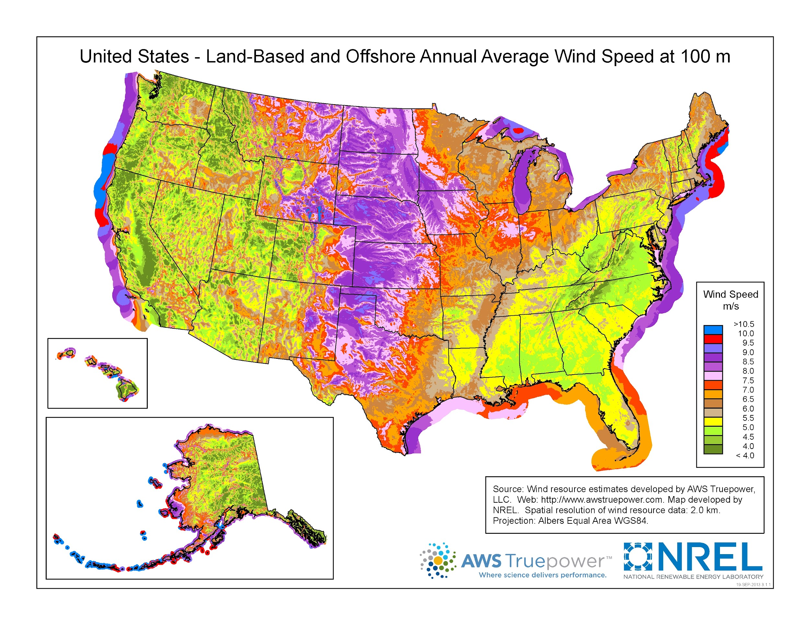

Slide 18
Phases of Offshore Wind
Pre-Construction
Federal Government action priors to Leasing Auctions
Lease Auction
Interested Parties actions
Financing
Exploratory Phase
Map the sea bottom
Core samples of potential sites
Scour for, and remove, unexploded ordinance and other hazards
OPPORTUNITIES: Survey and scout vessels (manned and unmanned)

Slide 19
Phases of Off Shore Wind con’t
Construction
Prep work on sites
Typically move 1,000 tons or more bottom sediment and rock to prep foundation site
Construction
Must be Jones Act Compliant
CHALLENGES & OPPORTUNITIES:
Feedering and other specialized vessels
Port Upgrades
Value of the supply chain ($60+B by 2030, nationwide)
Jobs
Operations & Maintenance

Slide 20
Overall Challenges/Opportunities
Need multi-year certainty to make multi-million dollar decisions
Port Funding
Inconsistent funding-frequently looked at as a local issue, not part of a system. (As opposed to consistent Federal funding for airports.)
In North Carolina the state has made significant investments
Offshore wind technology changing as we speak. Ex: floating vs. fixed on the sea bottom.
Jones Act Compliance
Building a Supply Chain
State and Local Economic Incentives
State Corporate Tax Rates
NC 2022 = 2.5%, decreasing to 0% by 2030
LA 2022 = 7.5% for >$150,000 bracket
Workforce Training
In North Carolina we bundle community College specialized training funding as part of our incentive packages.

Slide 21
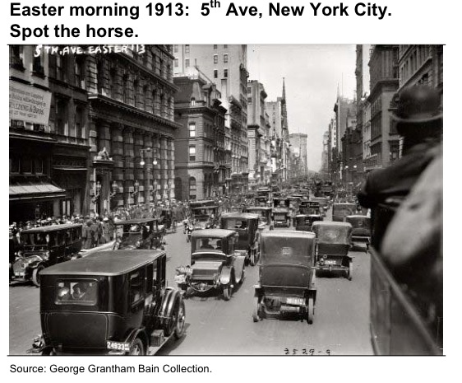
Policy - Technology & Innovation - Cost
Renewable Energy
Lessons Learned From North Carolina
Representative John Szoka
NC House of Representatives

